Slide 1

Public Relations
Rebranding to suit global needs
and increase awareness
Public Relations | Administration | Symposiums Presentation Spring 2018
Notes:
Public Relations of AguaClara is focusing on increasing overall exposure of the project team through the creation of an uniform brand that conveys the purpose and culture of the team. Public Relation’s team goals stem from AguaClara’s overall mission to innovate useful water filtration technologies focused around serving communities.
There are three main goals for this semester:
Maintain and Grow AguaClara Team Pride
Rebrand AguaClara to Suit Global Needs
Increase Awareness for Recruitment and Community Support
Since students are the driving force behind the project team, one of the purposes of this subteam is to continue to allow members to be proud and excited to be a part of AguaClara. A formalized and uniform brand is also needed especially since AguaClara is increasing its global reach. Increasing awareness within the Cornell community will allow the project team to have access to the highest quality of talent. Meanwhile, obtaining external awareness increases AguaClara legitimacy within the larger engineering community. All of the targeted projects this year will be working towards these three goals.
Link to full Report: https://docs.google.com/a/cornell.edu/document/d/1D-NSVFW7CDtq2wyHmfC5HEhWWLA9H15WC0GzMMHDZks/edit?usp=sharing

Slide 2


Rebranding: Out With the Old
Public Relations | Administration | Symposiums Presentation Spring 2018

Slide 3
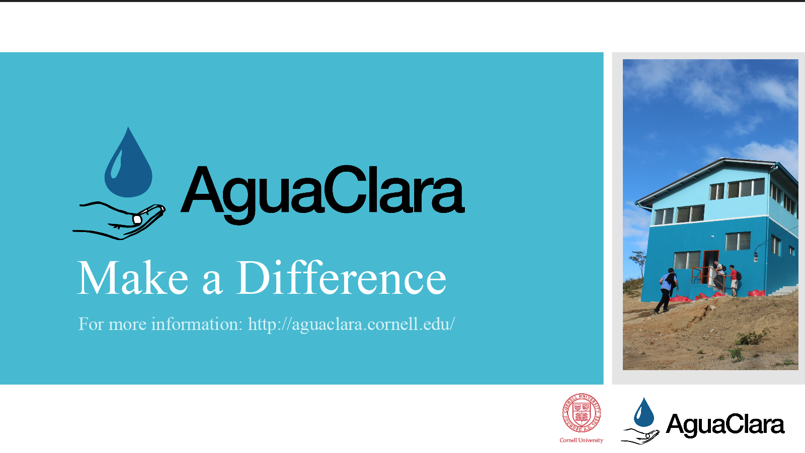
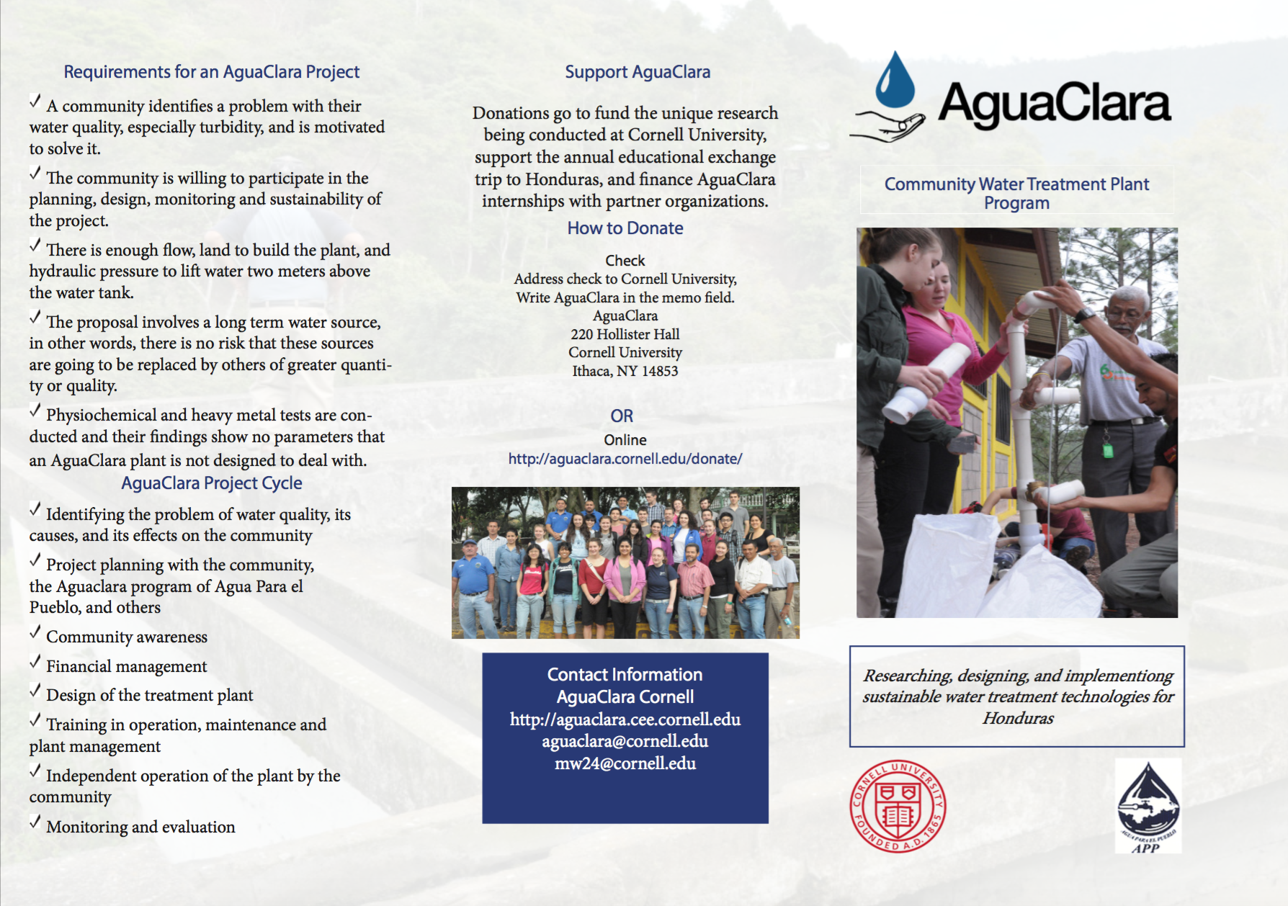
Rebranding: Out With the Old
Public Relations | Administration | Symposiums Presentation Spring 2018

Slide 4

Rebranding: In With the New
Updating our logo to differentiate ourselves from AguaClara Reach
Public Relations | Administration | Symposiums Presentation Spring 2018
Notes:
Lastly, we need to make sure we continue to increase awareness in order to obtain support in terms of donations and exposure. With external exposure needs to come internal exposure as well. Student talent is the core to the innovation of AguaClara, it should be our priority to be able to recruit from the most talented and passionate pool of recruits.

Slide 5
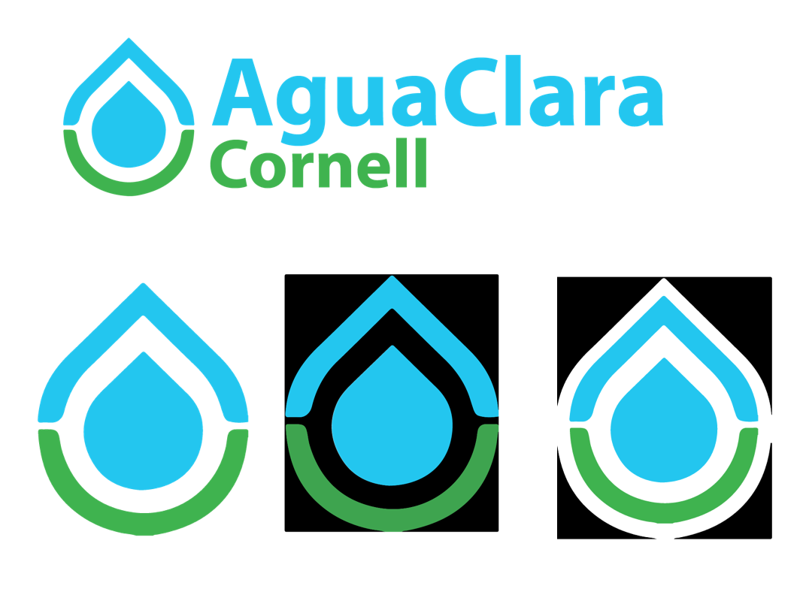
Rebranding AguaClara: Logo
Public Relations | Administration | Symposiums Presentation Spring 2018

Slide 6
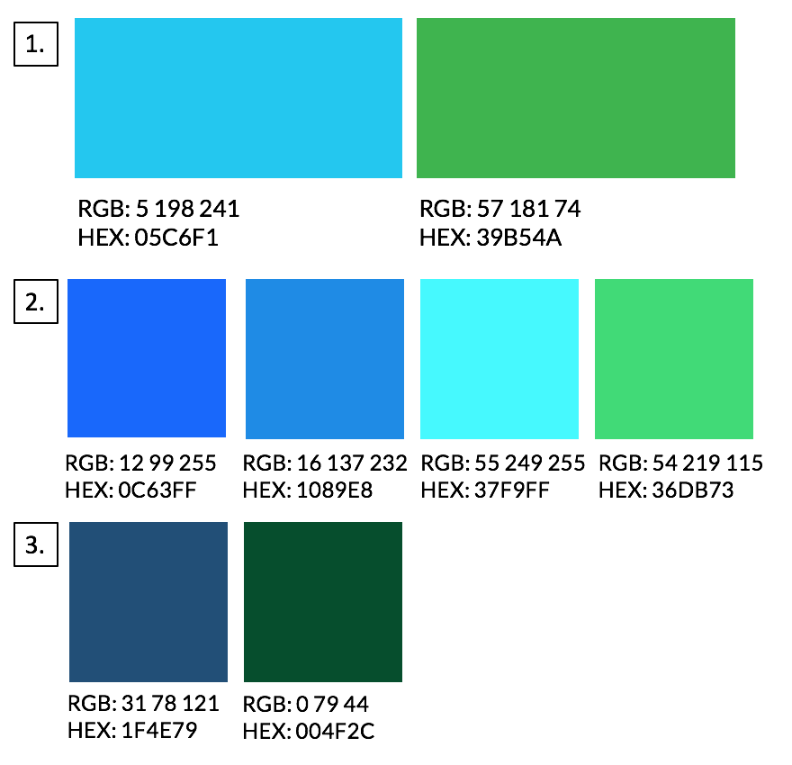
Rebranding AguaClara: Colors
Public Relations | Administration | Symposiums Presentation Spring 2018
Notes:
RGB: 31 78 121 1F4E79
RGB: 132 207 224

Slide 7
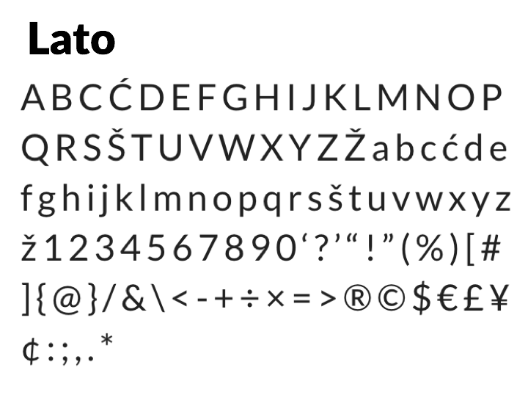
Rebranding AguaClara: Fonts
Public Relations | Administration | Symposiums Presentation Spring 2018
Notes:
We have chosen the font lato as our main font. Lato is a sans serif typeface family created by designer Lukasz Dziedzic. It is meant to portray harmony and elegance, as well as stability. Lato is simple and works well as body text, but also displays unique traits when used in larger sizes making it able to be used as titles as well.

Slide 8
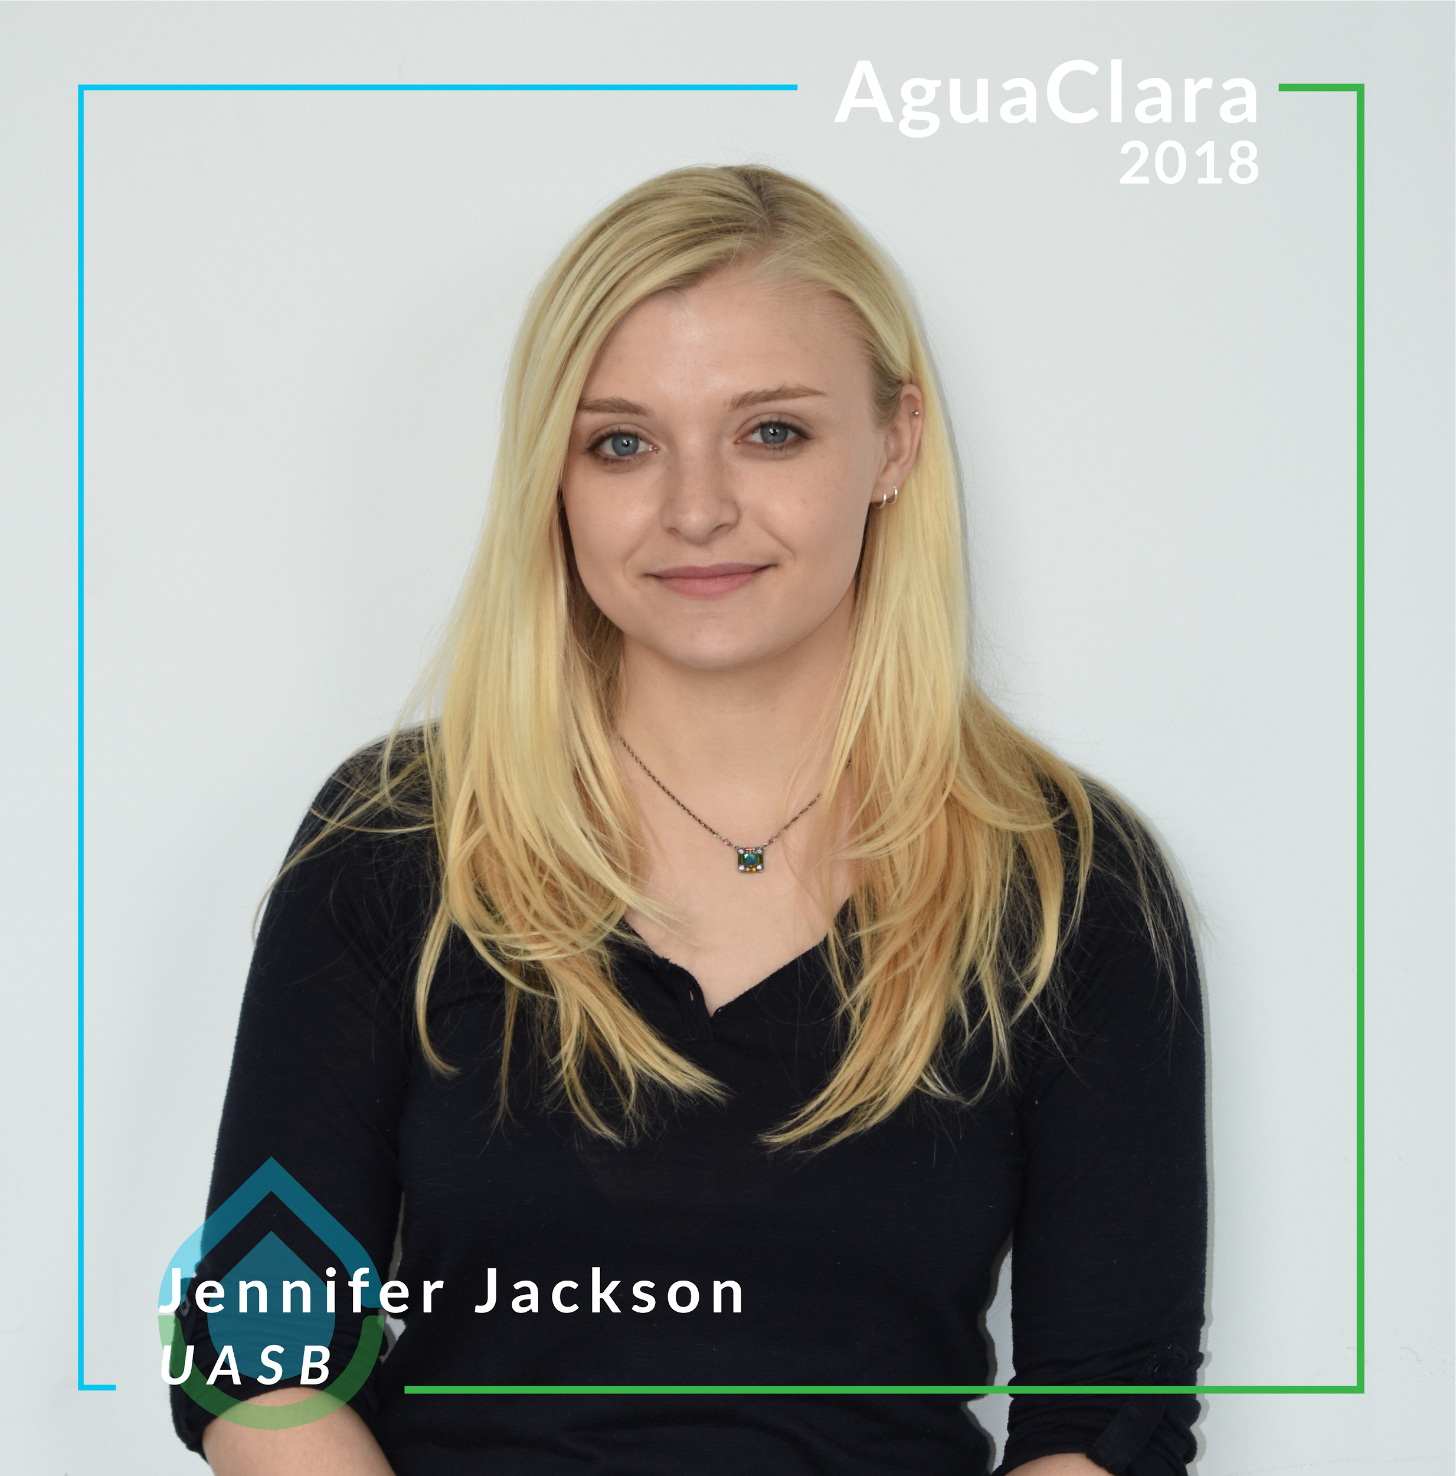
Social Media: Facebook
We are informing the public about AguaClara members and their current projects.
Public Relations | Administration | Symposiums Presentation Spring 2018
Notes:
The goal of posting Spotlights is to increase the awareness and reach of the organization. The Spotlights will allow the general public to learn more about AguaClara members and current projects. In addition, they will foster team spirit through allowing members of AguaClara to learn more about their teammates.

Slide 9
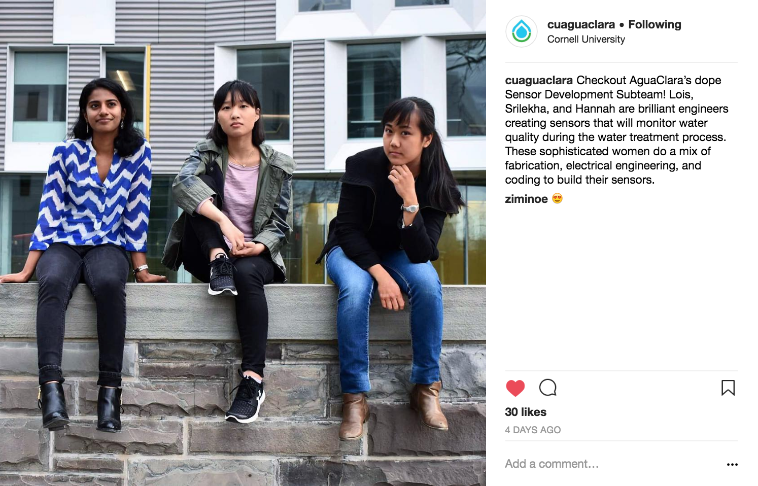
Social Media: Instagram
Public Relations | Administration | Symposiums Presentation Spring 2018
Notes:
VP Lombardi AND ISA follows us

Slide 10
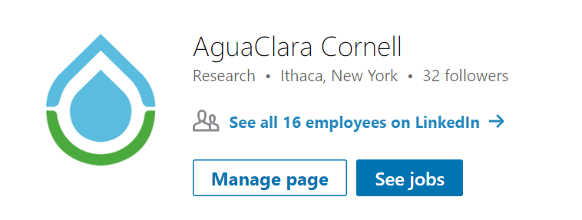
Social Media: LinkedIn
The new LinkedIn profile is the owner of the business page and the group.
Public Relations | Administration | Symposiums Presentation Spring 2018

Slide 11
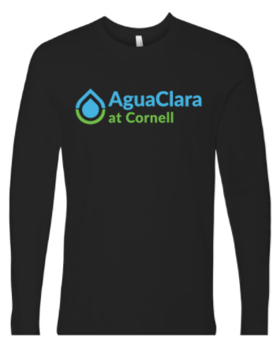
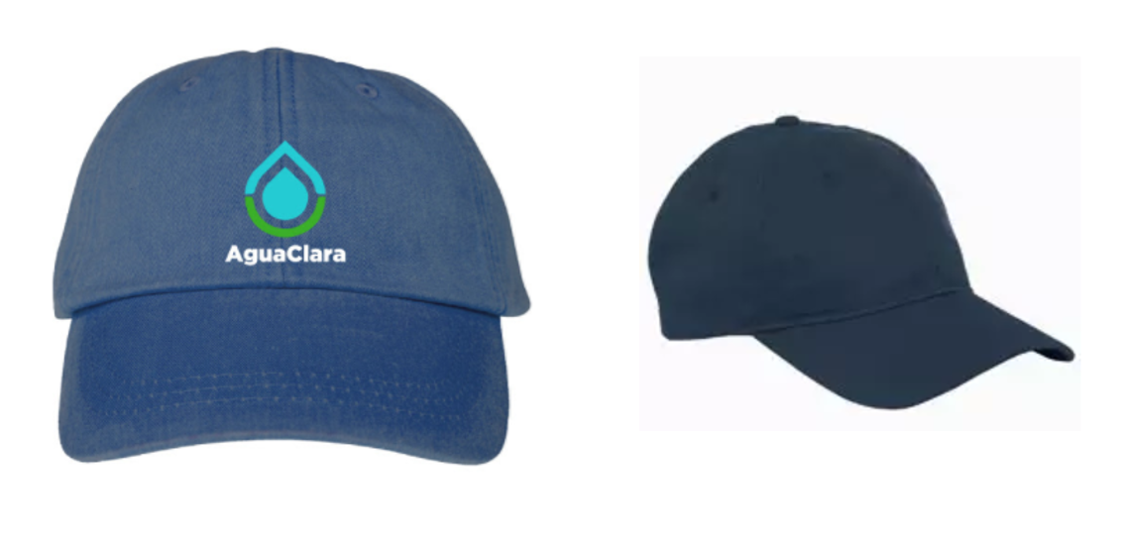
Merchandise: Apparel
Long sleeve shirt and hat with updated logo
Public Relations | Administration | Symposiums Presentations Spring 2018
Notes:
Stickers, sweatshirt most popular
Long sleeve shirt
Water bottles
Baseball caps, t-shirts
people also offered comments like they would be interested in water bottles if it was a nalgene

Slide 12

Merchandise: Stickers
Sticker sheet features our new logo and motto of “research, invent, design”
Public Relations | Administration | Symposiums Presentations Spring 2018

Slide 13
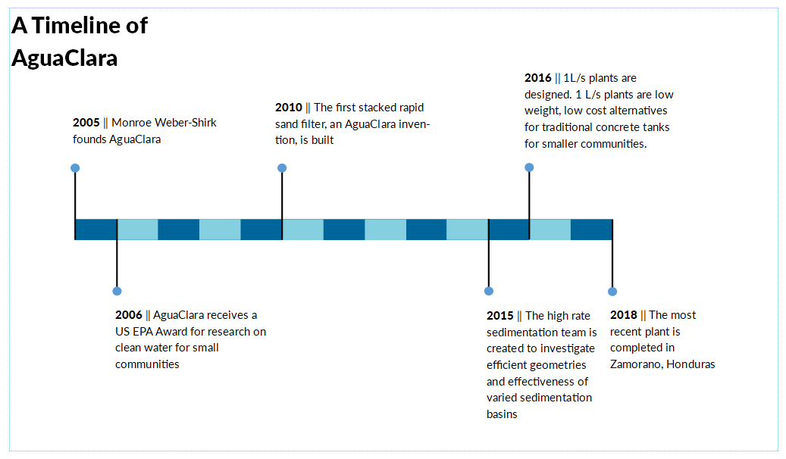
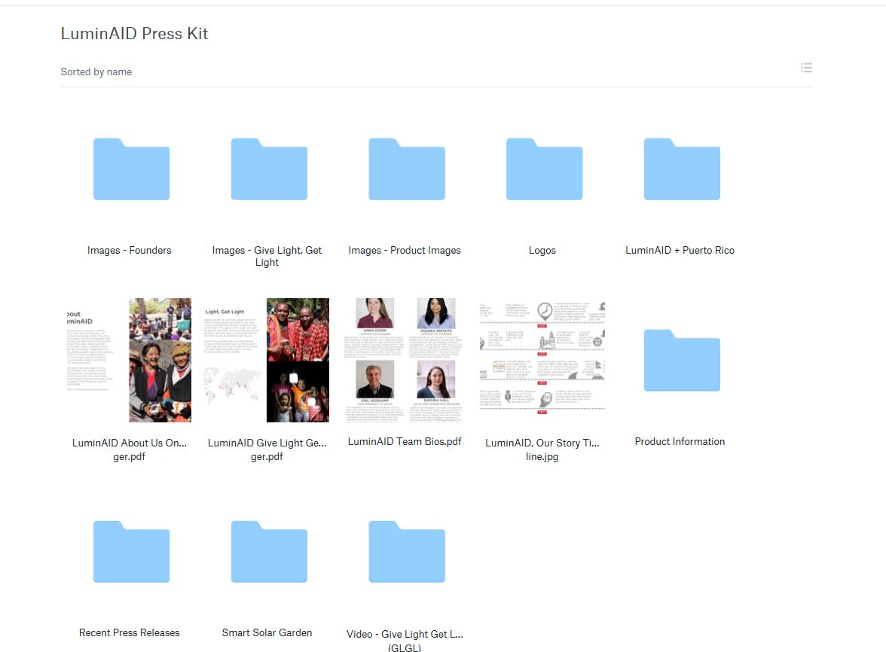
Promotional Materials: Press Kit
The press kit is composed of a series of one-pagers and folders with images.
Public Relations | Administration | Symposiums Presentation Spring 2018

Slide 14
Promotional Materials: Press Kit
Official Mission Statement of AguaClara Cornell
AguaClara Cornell upholds and protects the fundamental human right to access safe drinking water. We are committed to the ongoing development of resilient, gravity-powered drinking water and wastewater treatment technologies. Students lead the innovation process, learn from each other, and foster a collaborative environment where diversity is celebrated, failures are learning opportunities, and success is shared. We research, invent, and design technologies that are implemented by partner organizations and managed by communities to bring safe water on tap!
The press kit is composed of a series of one-pagers and folders with images.
Public Relations | Administration | Symposiums Presentation Spring 2018

Slide 15
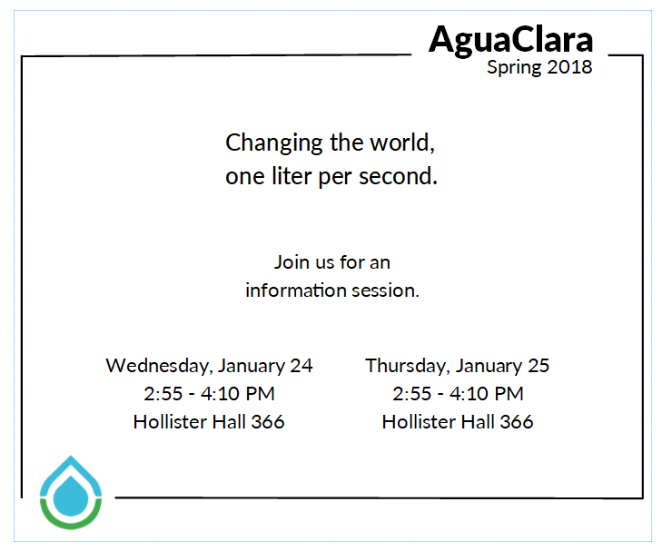
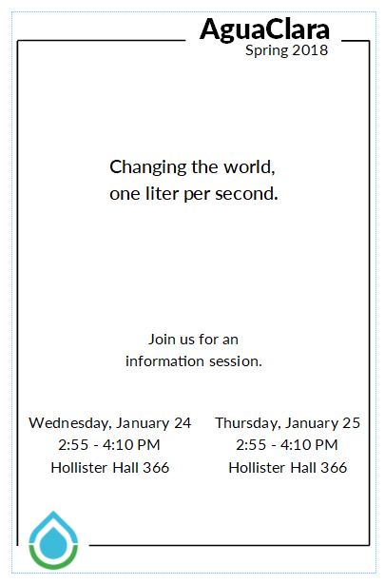
Promotional Materials: Templates
Templates for quarter cards during recruitment
Public Relations | Administration | Symposiums Presentation Spring 2018

Slide 16
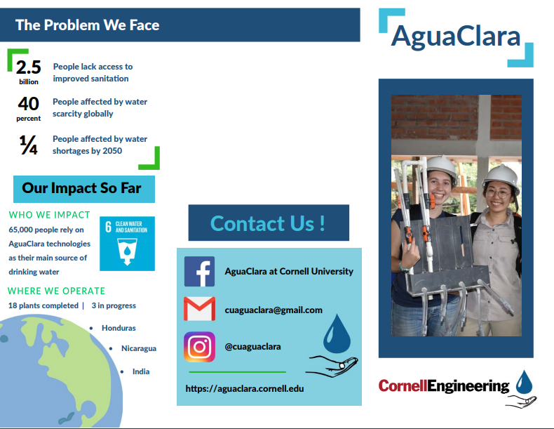
Promotional Materials: Templates (cont.)
Brochure template completed with general information about AguaClara
Public Relations | Administration | Symposiums Presentations Spring 2018
Notes:
Next semester, We’ll need to update this brochure with new logos and

Slide 17
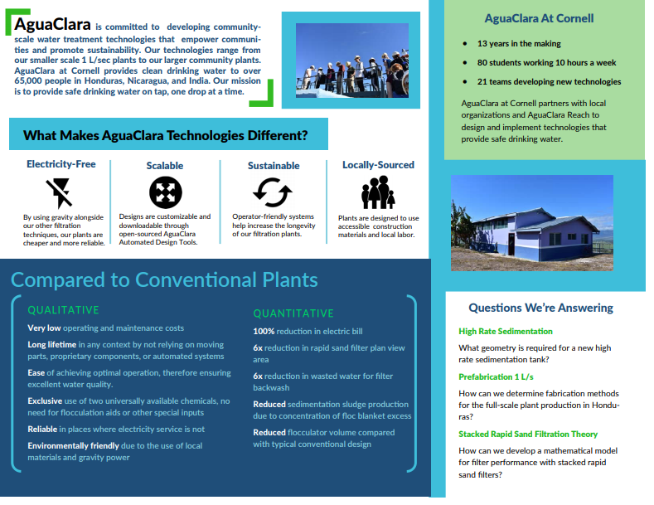
Promotional Materials: Templates (cont.)
Brochure template completed with general information about AguaClara
Public Relations | Administration | Symposiums Presentations Spring 2018

Slide 18
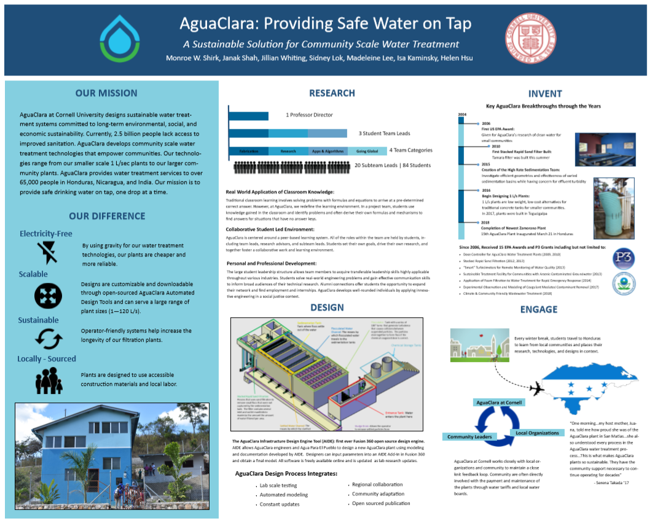
Promotional Materials: Templates (cont.)
Poster for the ASEE conference
Public Relations | Administration | Symposiums Presentations Spring 2018
Notes:
AguaClara also has a poster for ASEE, in which we wont the poster

Slide 19
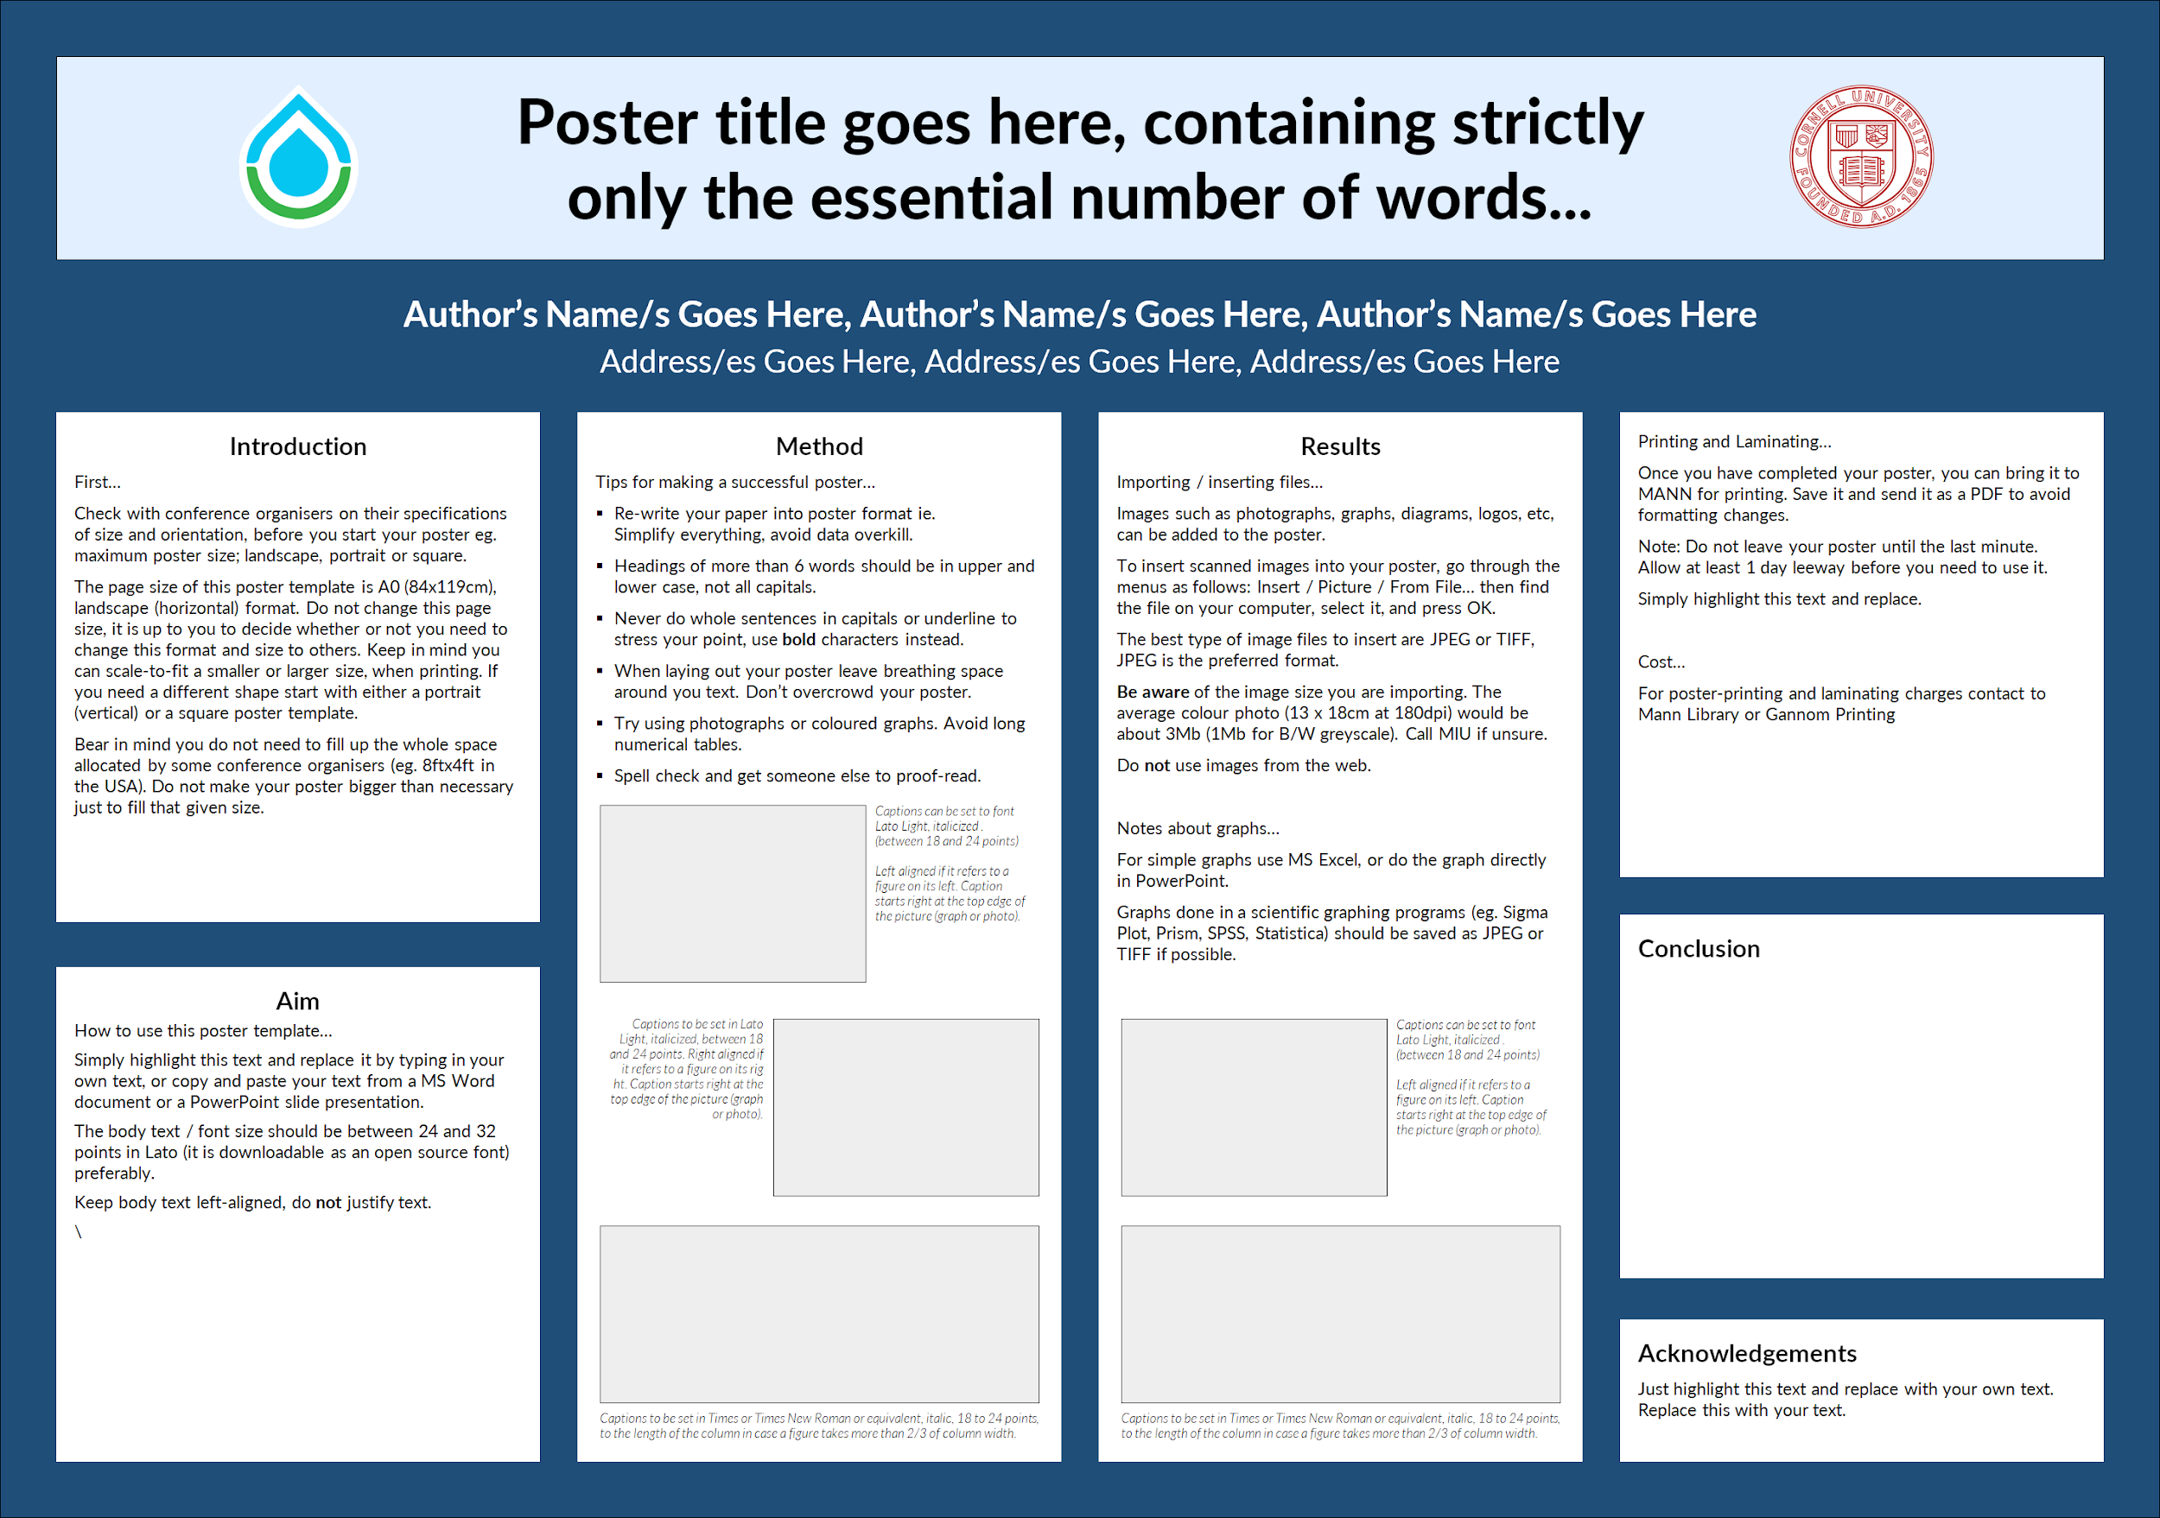
Promotional Materials: Templates (cont.)
Poster template, dark theme
Public Relations | Administration | Symposiums Presentations Spring 2018
Notes:
Public Relations also made poster templates for technical writing so any subteams

Slide 20
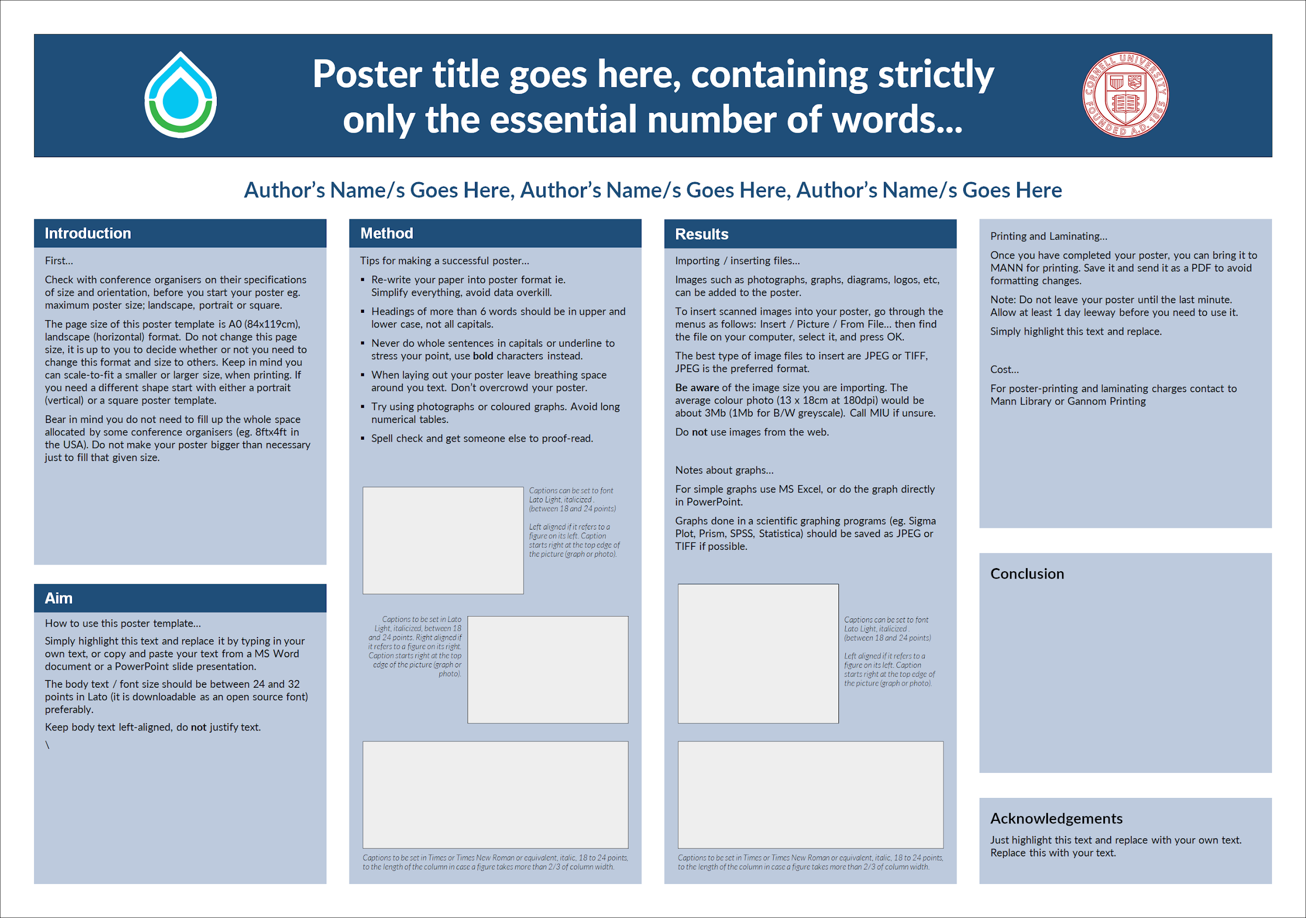
Promotional Materials: Templates (cont.)
Poster template, light theme
Public Relations | Administration | Symposiums Presentations Spring 2018
Notes:
Screenshot from Giving Day page for AguaClara. Note how we incorporated the fonts and color scheme.

Slide 21
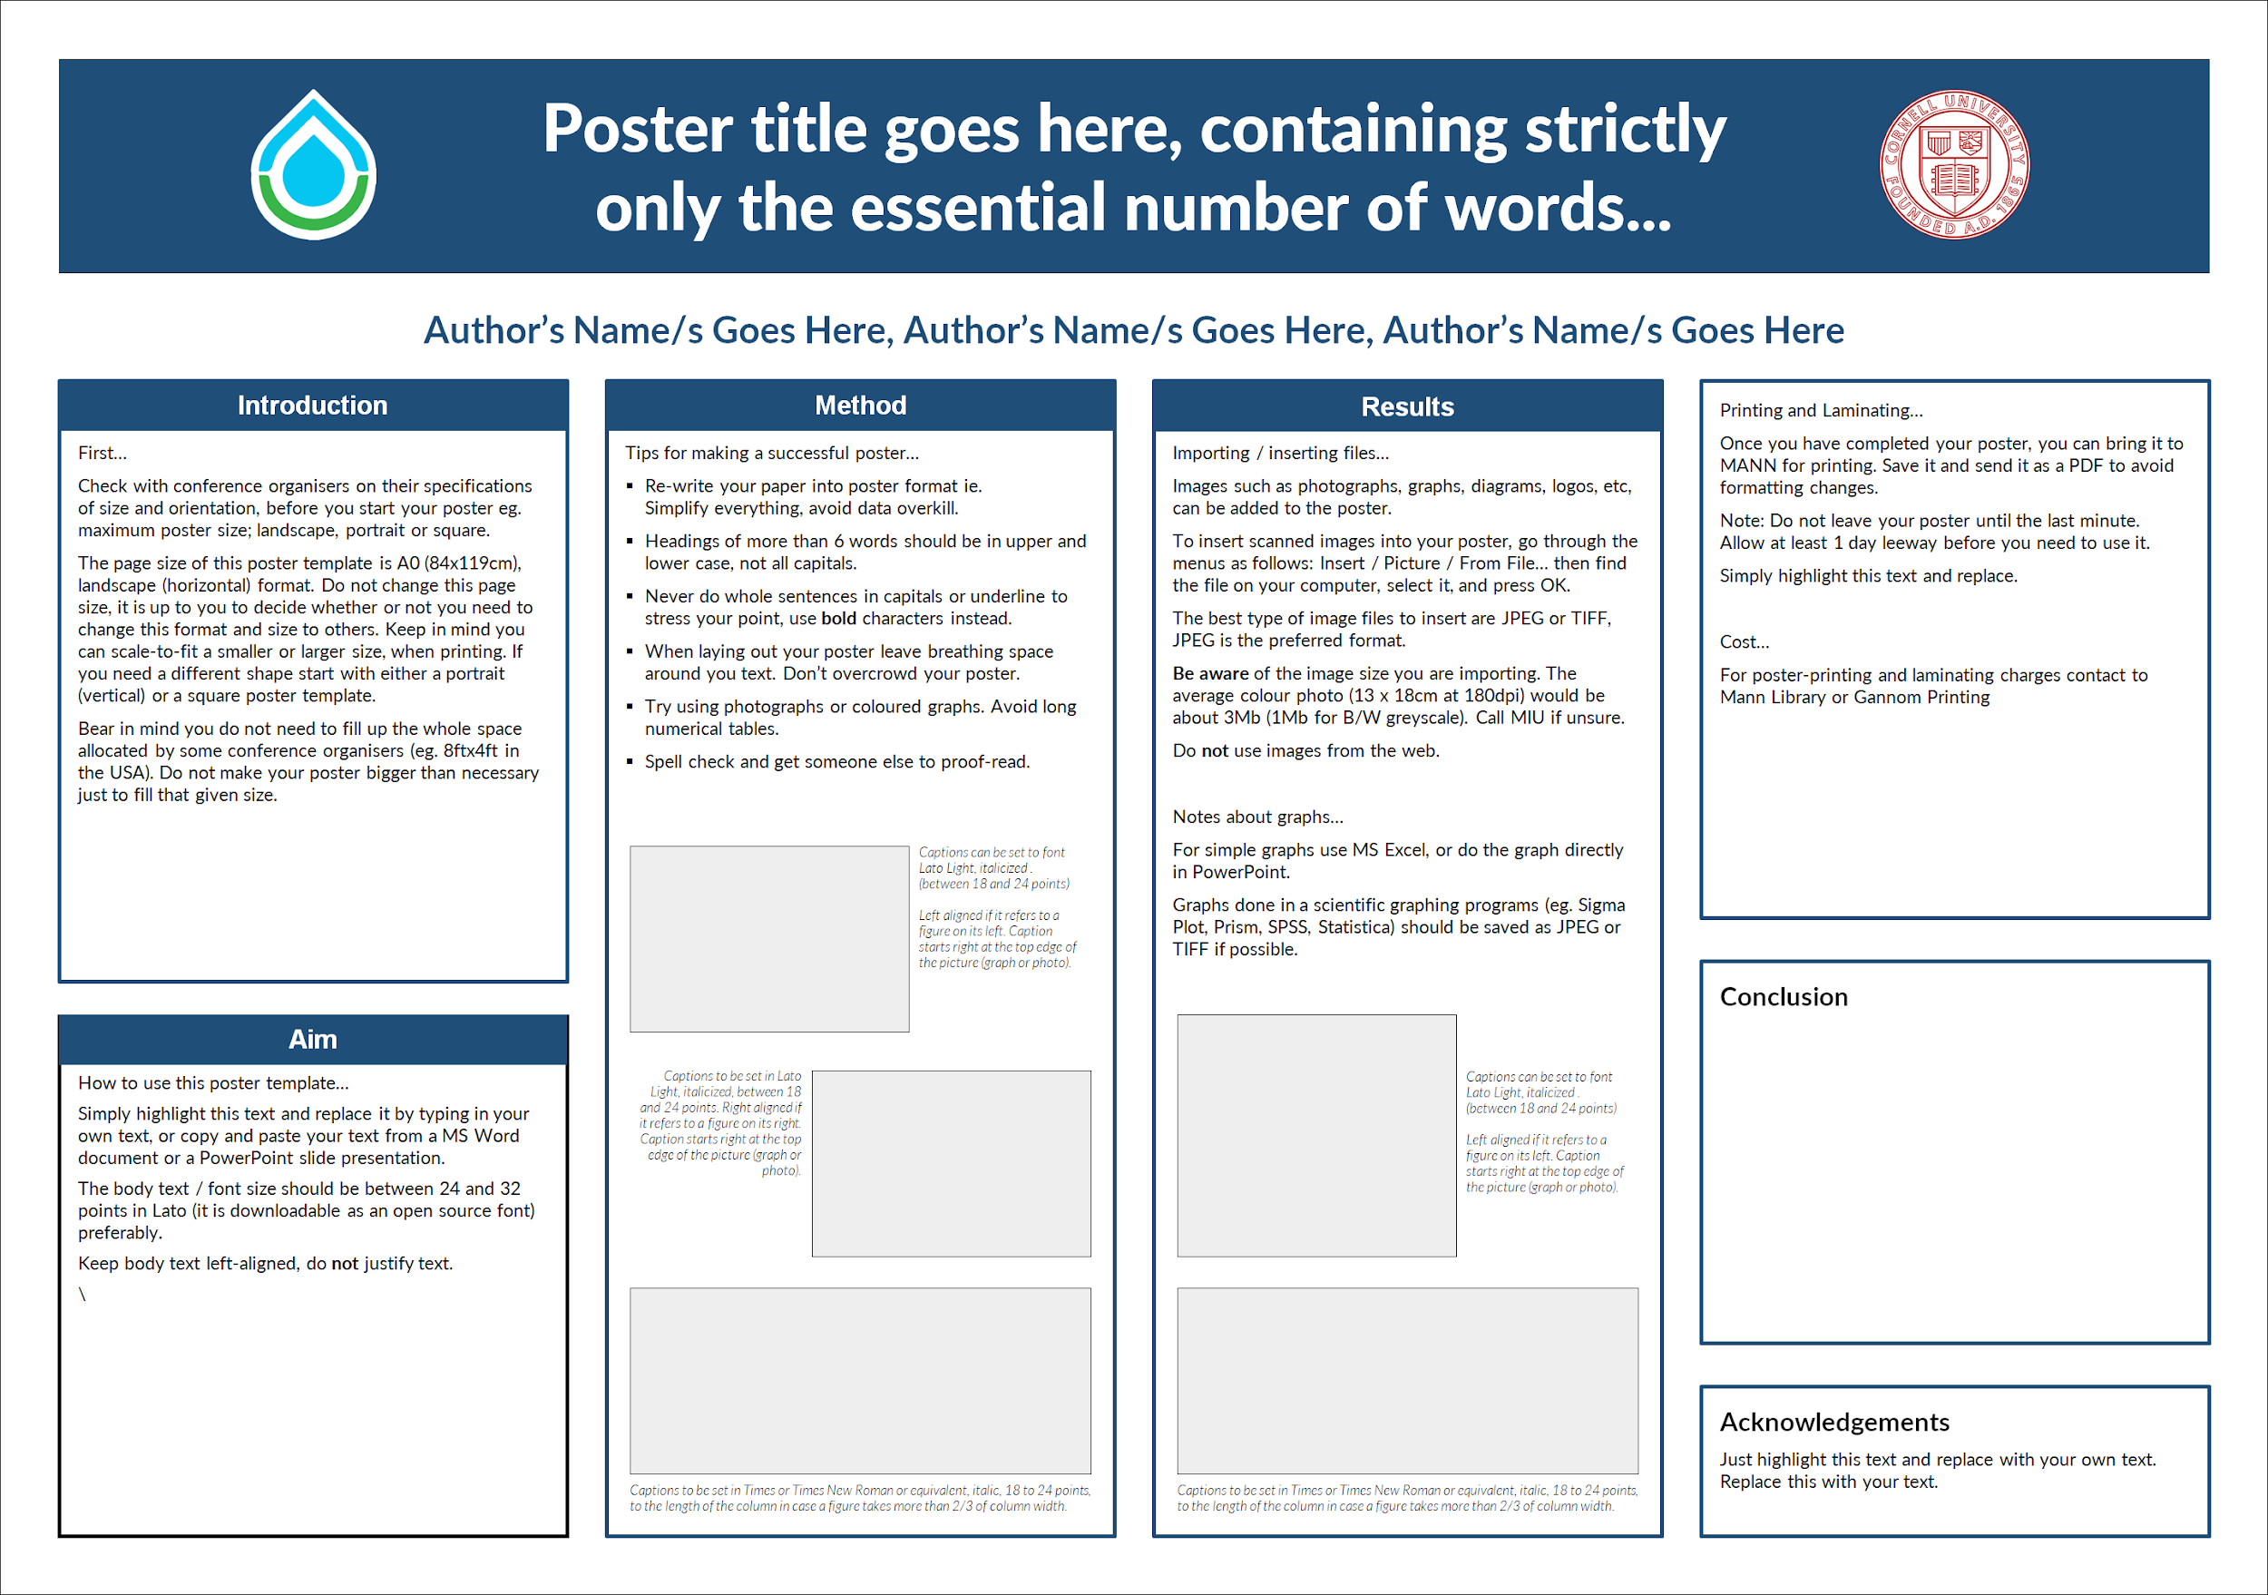
Promotional Materials: Templates (cont.)
Poster template, light theme
Public Relations | Administration | Symposiums Presentations Spring 2018

Slide 22
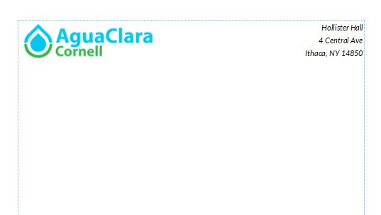
Promotional Materials: Templates (cont.)
Letterhead
Public Relations | Administration | Symposiums Presentations Spring 2018

Slide 23
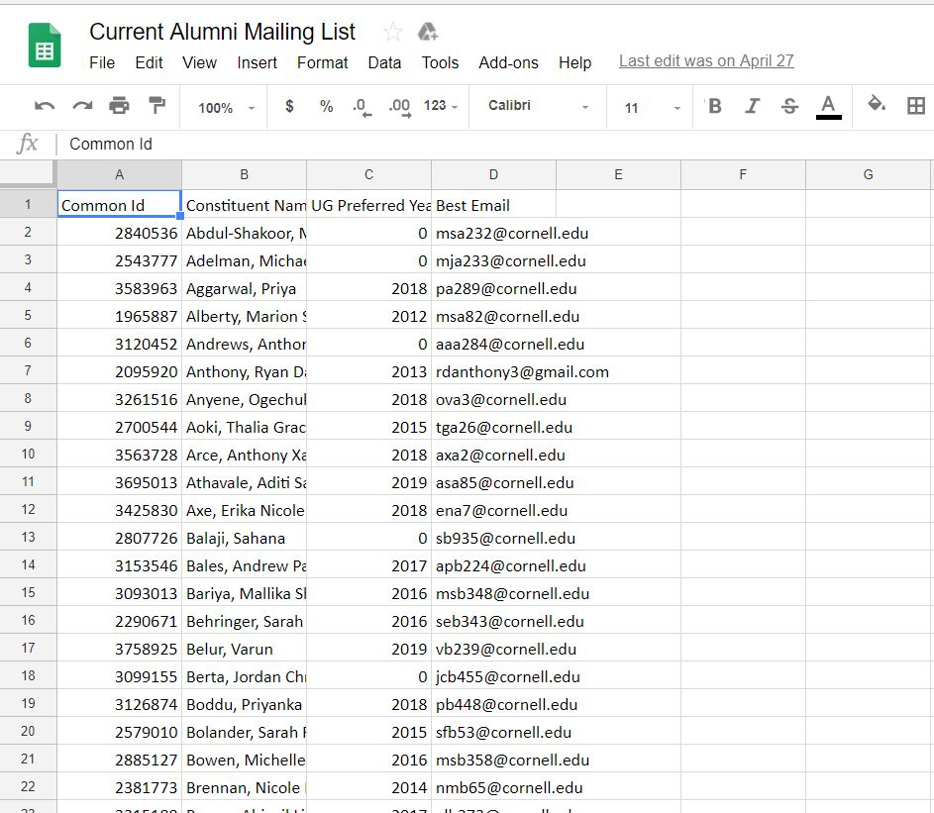
Alumni Outreach
Public Relations | Administration | Symposiums Presentations Spring 2018
Notes:
2 projects

Slide 24
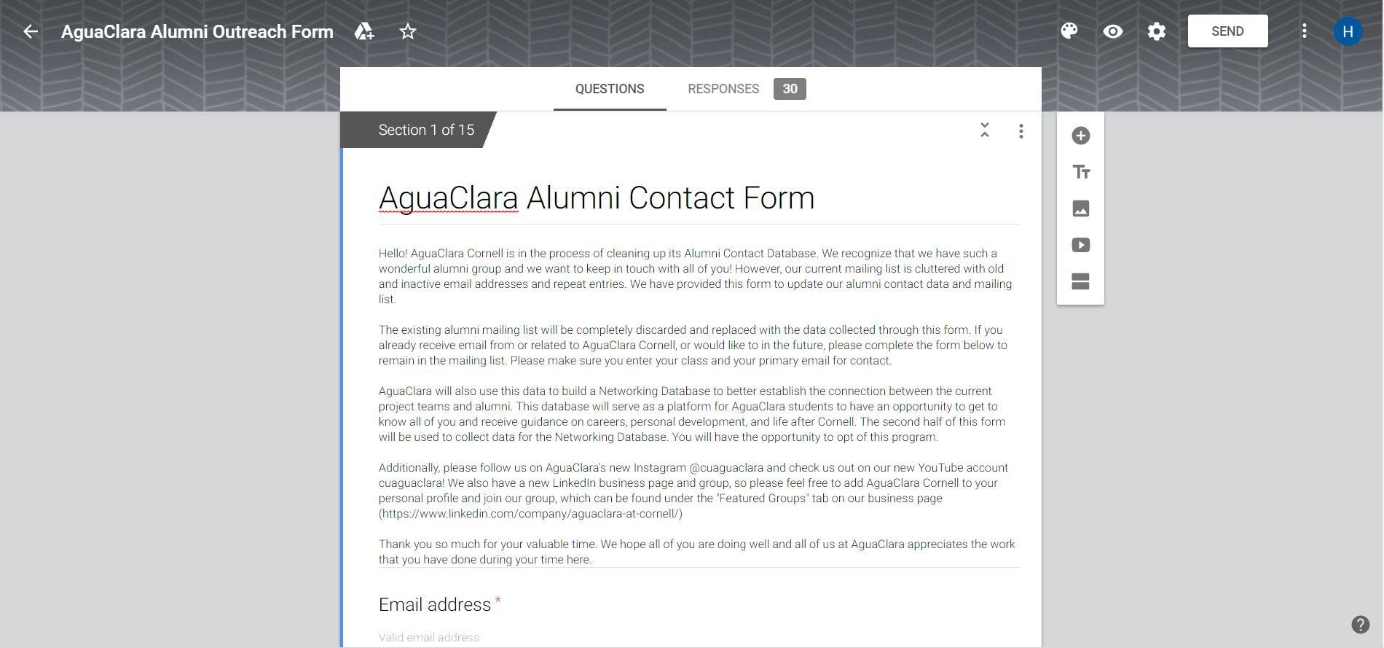
Alumni Outreach
Public Relations | Administration | Symposiums Presentations Spring 2018

Slide 25
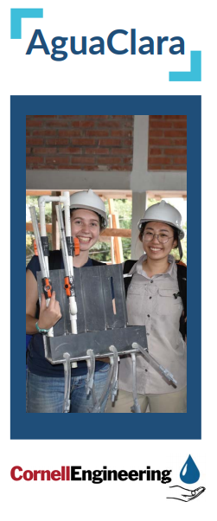
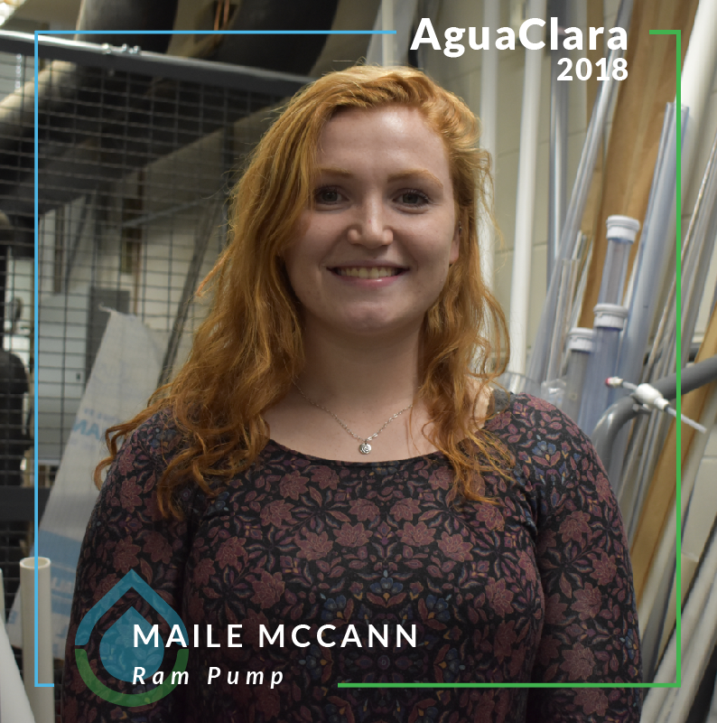
Future Projects
Create and Update Templates
Continue Media Posts
Complete Press Kit
Sell Surplus Merchandise
Public Relations | Administration | Symposiums Presentations Spring 2018

Slide 26

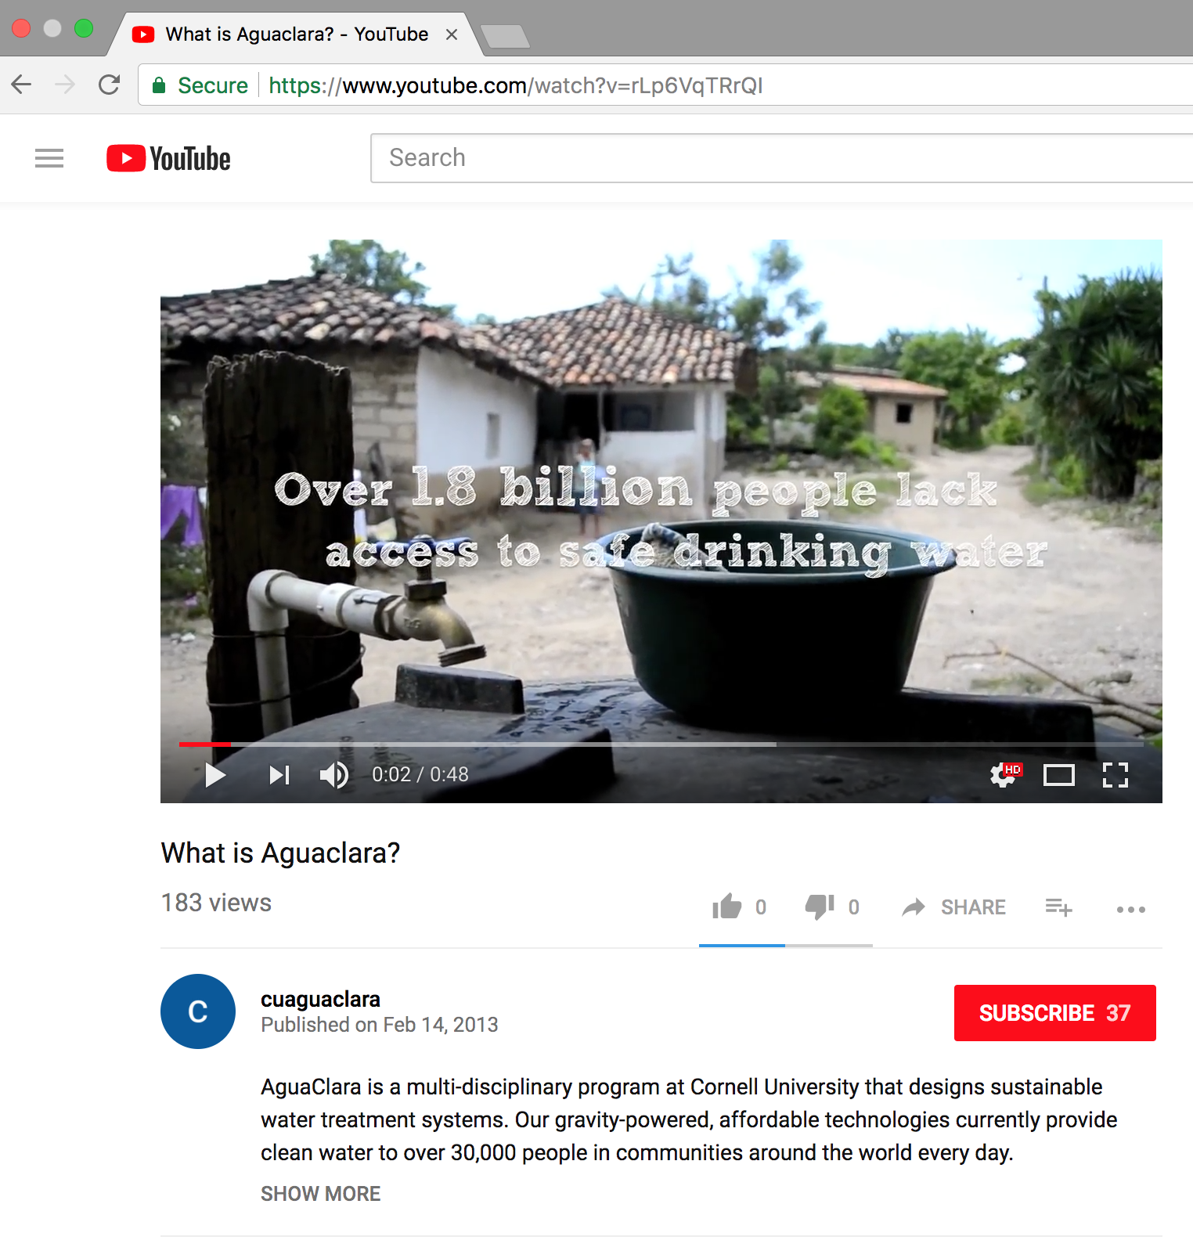
Increasing AguaClara Exposure
AguaClara Promotional Video
AguaClara Bi-semesterly Newsletter
Public Relations | Administration | Symposiums Presentations Spring 2018
Notes:
Two other projects that the current and future PR teams will work on are promotional videos and newsletters. We hope to get footage from this year’s trip to Honduras to use in the video, which will then be edited and used to garner interest in the team. The newsletter is currently inaccessible due to administrative login issues, however we hope to post them bi-semesterly. They will increase engagement for both current and past members of the project team.

Slide 27
What future PR teams should work on
Obtaining more SAFC Funding
Participate in Recruitment
Recruit PR Members with Adobe Suite experience and Graphic Design Skills
Public Relations | Administration | Symposiums Presentations Spring 2018
Notes:
PR teams should create materials and templates that can be utilized beyond one semester, so future members can easily access and use them.
Through re-branding it has been found that experience with Adobe Creative Suite and design and media skills is extremely advantageous for producing tasteful PR material

Slide 28
Questions
and
Recommendations
Helsen Hsu
Applied Economics & Management
hh464@cornell.edu
Isa Kaminsky
Biological Sciences
imk28@cornell.edu
Madeleine Lee
Environmental Engineering
ml895@cornell.edu
Public Relations | Administration | Symposiums Presentations Spring 2018

Slide 29
Appendix
Slides
Public Relations | Administration | Symposiums Presentations Spring 2018

Slide 30











Appendix
Public Relations | Administration | Symposiums Presentations Spring 2018
Notes:
The large logo at the center was borrowed from AguaClara Reach.
The remaining logos were all designed by us. The logos on the far right were part of the first iteration of logos. The designs on the right are the current iteration, and we are deciding which design to proceed with.
Take a general poll of the audience asking whether they prefer the “brain” design or the “clocktower” design, independent of color.
If there is time, take a general poll of the audience asking which color they prefer.

